Slide 1
Clockster: An Analysis of Tardiness and Absences in a Medical Company
Ezekiel Adriel D. Lagmay

Slide 2
Background
The HR Department in a medical company wants to know the following information about employee attendance and leaves:
Identify the most disciplined and undisciplined employees and divisions
Create a visualization with the analysis of weekdays and months when the most employees were late/absent (either for vacation or sick leave)
Which heads of departments tend to forgive employees for lack of discipline? Are there any favorites for any heads of departments (perhaps some employees are always forgiven for being late, given time off, etc.)?

Slide 3
Dataset Description
users - The list of all users (employees) and their basic information including the date of hire, date of leave, gender, department, position, etc.
payroll - Contains information about the pay employees will receive for a particular time period.
schedules - The schedules for the shifts of each employee. For this study, schedules pertaining to leaves and work are only considered.
leave_requests - All requests for leaves. If approved, the requested leave will show up on the schedules dataset.
attendance - The time in and time out recorded for each employee when reporting to work.

Slide 4
Dataset Preprocessing
Using Excel:
Renamed the case column in the attendance data to type to avoid problems in the later preprocessing stages via PostgreSQL.

Slide 5
Dataset Preprocessing
Using PostgreSQL:
Cleaned the comma-separated text strings in the dates column (schedules and leave_requests), and in the user_id column (schedules), allowing for splitting and unpivoting of these columns later in Power Query.
Concatenated the time_start and time_end columns with the timestamp column for schedules, and the date, time, and timestamp columns for attendance.
Split the schedules data into work and leaves, and split the attendance data into in and out datasets.
Saved the results to respective CSV files.

Slide 6
Dataset Preprocessing
Using PowerBI (Power Query):
Removal of duplicates:
Via user_id (users), user_id and date (leave_requests, schedules - leaves), user_id, date_start, and date_end (payroll)
Grouped by user_id and date and obtained the min timestamp (attendance - in) or max timestamp (attendance - out)
Grouped by user_id and date and obtained the min timestamp_start and max timestamp_end (schedules - work)
Split by comma and unpivoted other columns for columns holding comma-separated values (schedules - work, schedules - leaves, and leave_requests)
Full outer joined the schedules - work and schedules - leaves, and then merged the leave_requests (status), payroll, attendance - in, attendance - out, and users (created_at, date_hired, date_leave) data into it.

Slide 7
Dataset Preprocessing
Using PowerBI (DAX):
Calculated columns to indicate if a schedule record is:
Within employment period: Date should be between the date_hired (or created_at if date_hired is blank), inclusive, and date_leave (or none at all), exclusive.
Arrived late: The difference between time in and the scheduled time start in seconds.
Left early: The difference between scheduled time end and time out in seconds.
Basic Monthly Salary: Calculated based on the basic salary rate and the basic salary type (hourly, daily, or monthly).

Slide 8
Dataset Preprocessing
Using PowerBI (DAX):
An employee is tardy for a particular day if a schedule record within the employment period has a time in and/or time out recorded and has arrived late by at least 10 minutes and/or left early. Schedule records with lates or early timeouts of more than 2 hours are considered outliers and are hence not considered tardy.
An employee has an unscheduled absence for a particular day if a schedule record within the employment period has no time in and time out recorded and there is no leave type indicated.
An employee has a scheduled/leave absence for a particular day if a schedule record within the employment period has no time in and time out recorded and there is a leave type indicated.

Slide 9
Dataset Preprocessing
Using PowerBI (DAX):
For each employee, the number of distinct days wherein the employee was tardy or absent is calculated.
For each department, the average number of distinct days with tardiness/absence per employee (for disciplined/undisciplined), the percentage of employees with tardiness/absence (for undisciplined forgiveness), and the percentage of approved leaves are calculated.
For each month and weekday, the number of distinct employees with tardiness/absences are calculated.
Demographic information such as basic monthly salary and gender are also considered in the analysis of lateness and day-offs.

Slide 10
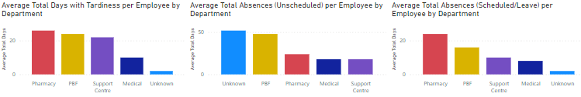
Results - Disciplined and Undisciplined Departments

Slide 11
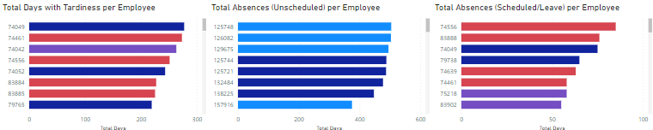
Results - Disciplined and Undisciplined Employees

Slide 12
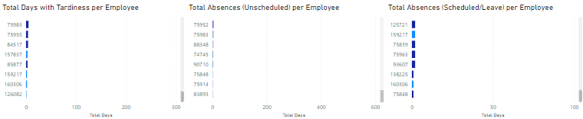
Results - Disciplined and Undisciplined Employees

Slide 13
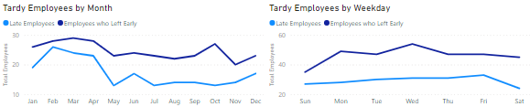
Results - Number of Employees with Lates or on Vacation/Sick Leave per Month and Weekday

Slide 14
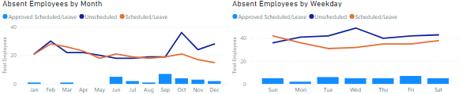
Results - Number of Employees with Lates or on Vacation/Sick Leave per Month and Weekday

Slide 15
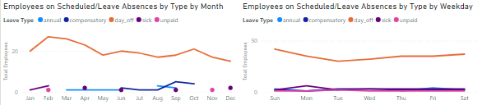
Results - Number of Employees with Lates or on Vacation/Sick Leave per Month and Weekday

Slide 16

Results - Most Forgiving Departments and Favorites

Slide 17
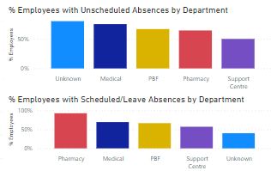
Results - Most Forgiving Departments and Favorites

Slide 18
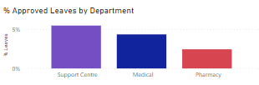
Results - Most Forgiving Departments and Favorites

Slide 19
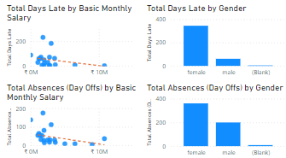
Results - Most Forgiving Departments and Favorites

Slide 20
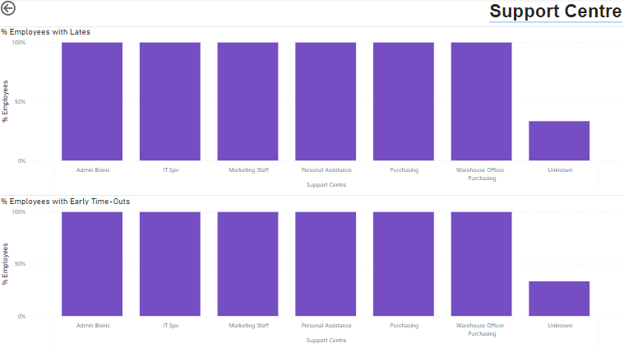
Results - Most Forgiving Departments and Favorites

Slide 21
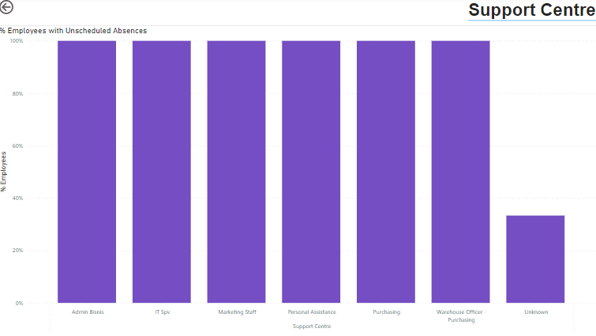
Results - Most Forgiving Departments and Favorites

Slide 22
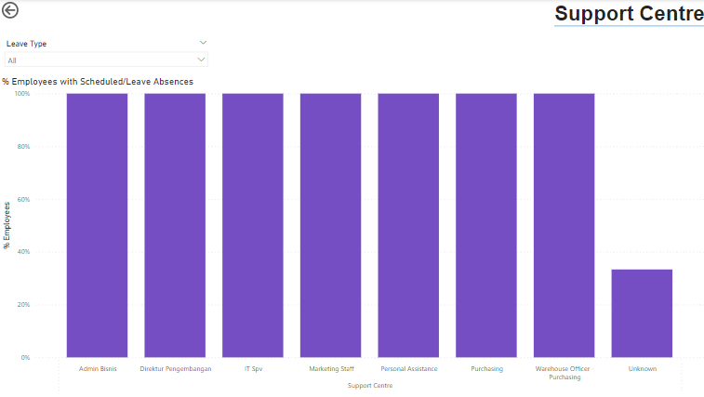
Results - Most Forgiving Departments and Favorites

Slide 23
Recommendations
Employees in the Unknown department should be educated on how to properly file leaves.
Encourage the Pharmacy, Medical, and Support Centre departments to enforce stricter guidelines in terms of tardiness and filing leaves, regardless of employee position.
The fact that there are more employees who left early than employees being late may indicate potential burnout and should be further investigated.
The fact that there are only a few recorded approved leaves might be an indication of inconsistency and inefficiency in the leave recording system and should be further investigated.
Very likely employees only think that day-off is the only type of leave available. Employees should be made aware of the other leaves that are available to them. Alternatively, this could also indicate burnout and should be further investigated.

Slide 24
Recommendations
One reason why employees with lower basic monthly salary are more likely to be late or file a day-off is because of employee demotivation. Efforts should be made to investigate the issue and offer salary raises if deemed necessary to motivate the employees.
The fact that female employees have more days late or day-offs than males should be further investigated, since this may indicate a work-life balance issue.

